Slide 1




BUAN 6333.501 Category Classification
Group 3
Lunven, Brieuc
Ndiema,Yuyu
Poulose, Albin
Yadav, Hiral
Zhang, Ling

Slide 2


Problem Statement
The project entails developing a dynamic simulation that replicates a real-world scenario where a client solicits proposals from various companies those aim to create tools for data analysis.
The classification tasks involve assigning appropriate categories to both single and multi-nominal feature set.

Slide 3

B_CLASSIFIER
C_CLASSIFIER
O_CLASSIFIER
takes a single
numeric input value and returns a class type, either 'bn' or 'bo'.
receives a vector of numeric values as input and returns a vector of strings with the same size/length. Each element in the output vector represents the class type ('cb' or 'cw') corresponding to the value in the input vector.
accepts a vector of numeric values as input, where the vector has a size/length of eight. It returns a single string value representing the class type of the input vector. Possible output values include 'o0', 'o1', 'o2', 'o3', 'o4', 'o5', 'o6', 'o7', 'o8', or 'o9'.

Slide 4
Algorithm Selection
Logistic Regression
Decision Tree & Random Forest
Ridge & Lasso Regression
Category Selection
Features are continuous variables

Slide 5
Feature Analysis
B Classifier
- Single feature
- Binominal categorical
- Single File Training Data
C Classifier
- Single Feature
- Binominal categorical
- Multi File Training Data
O Classifier
- Multi Feature
- Multinominal categorical
- Single File Training Data

Slide 6
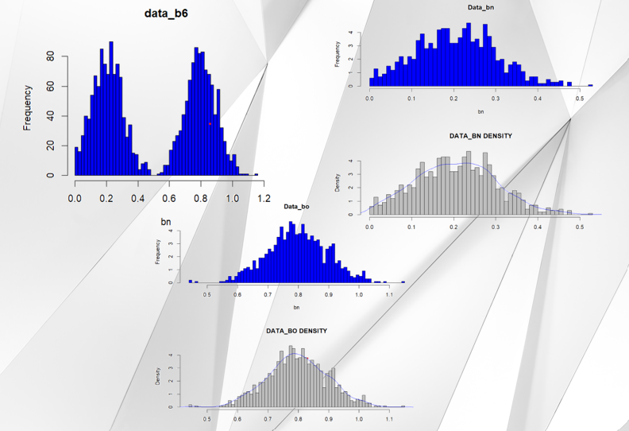
B Classifier
Data Analysis
Data is linearly distributed and for binomial categorical output, the best fitted algorithm is Logistic Regression.
glm(response ~ predictor, data = dataset, family = "binomial")

Slide 7
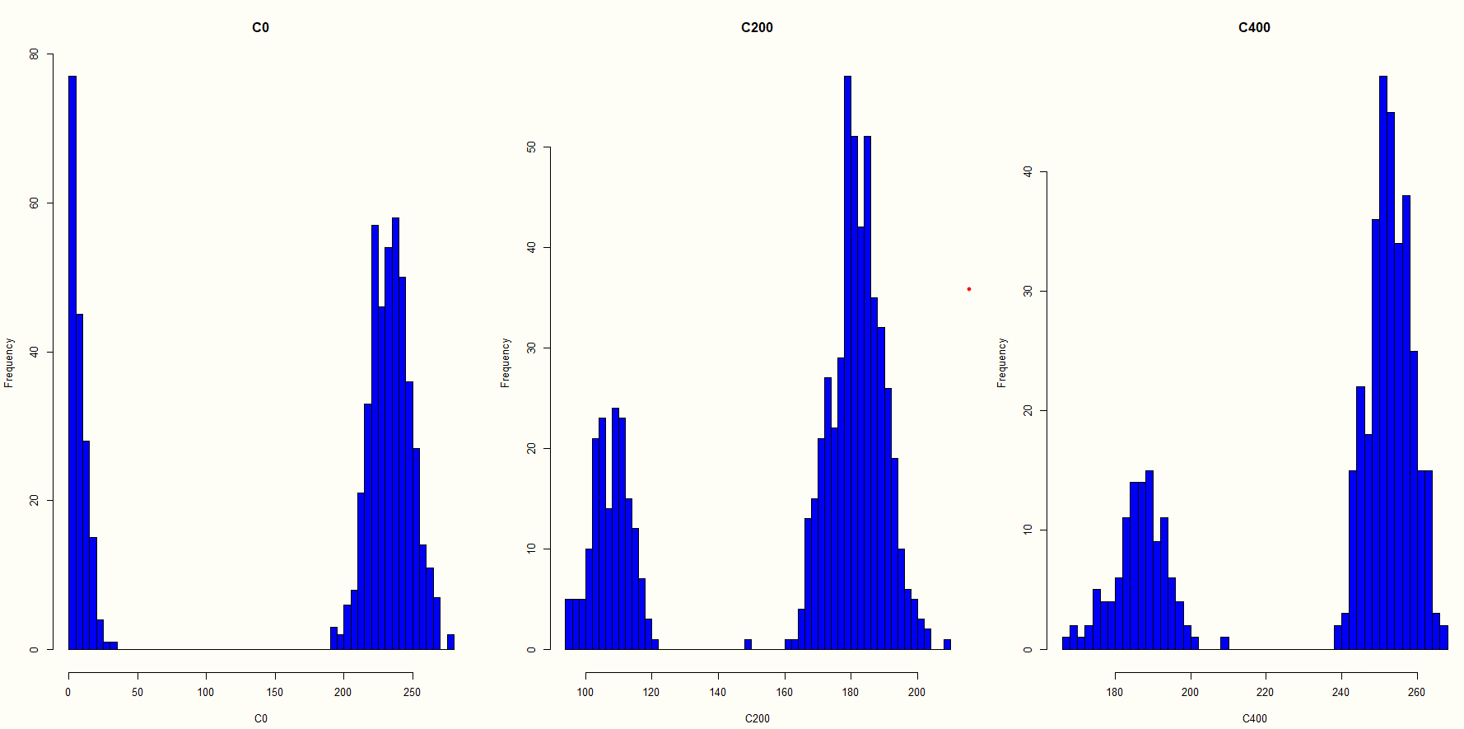
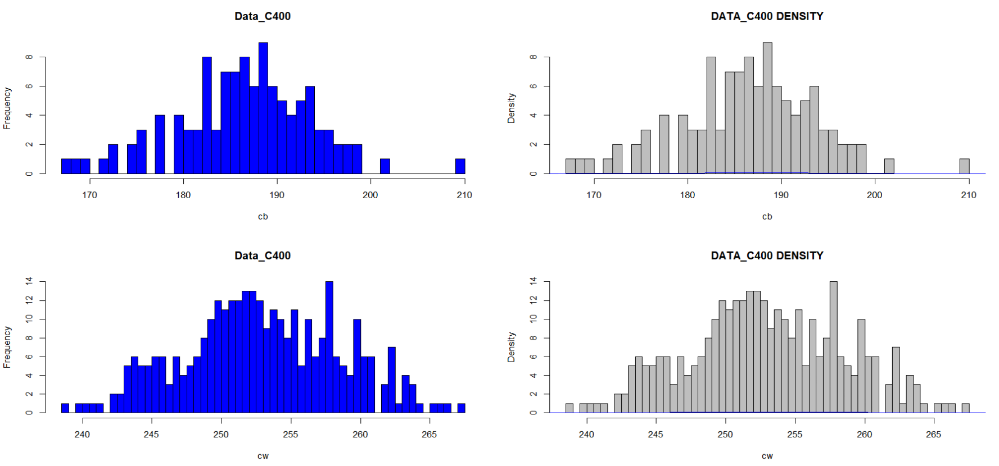
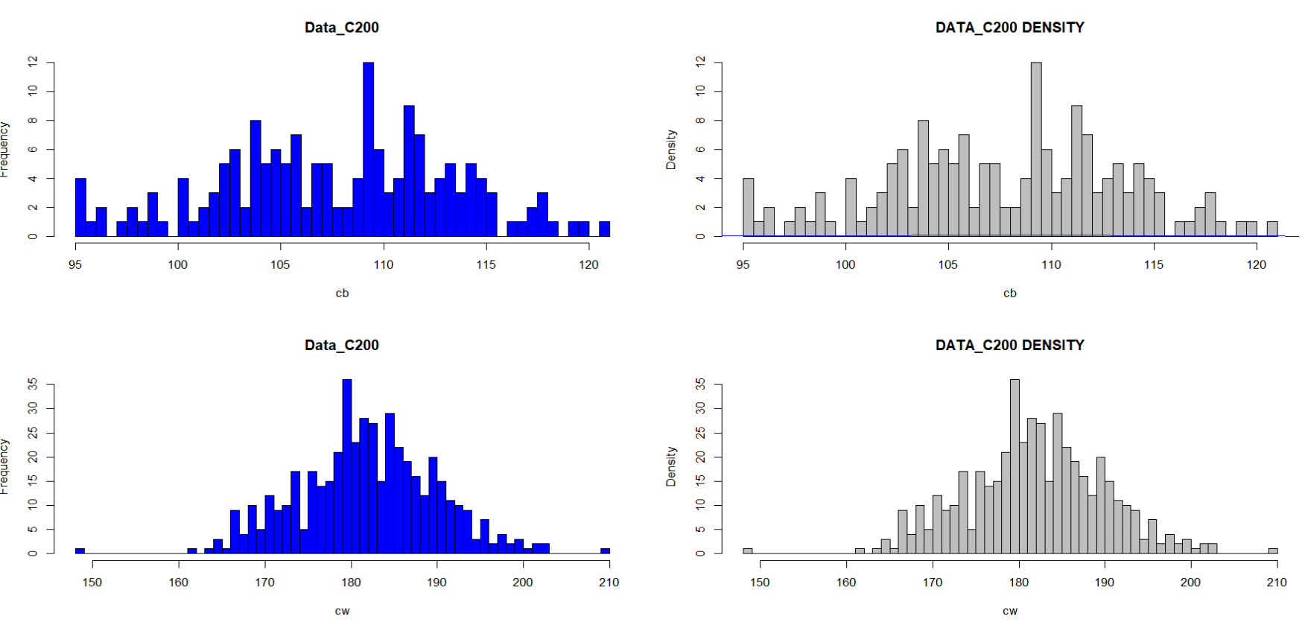
C Classifier
Data Analysis
Data is linearly distributed and for binomial categorical output, the best fitted algorithm is Logistic Regression.

Slide 8
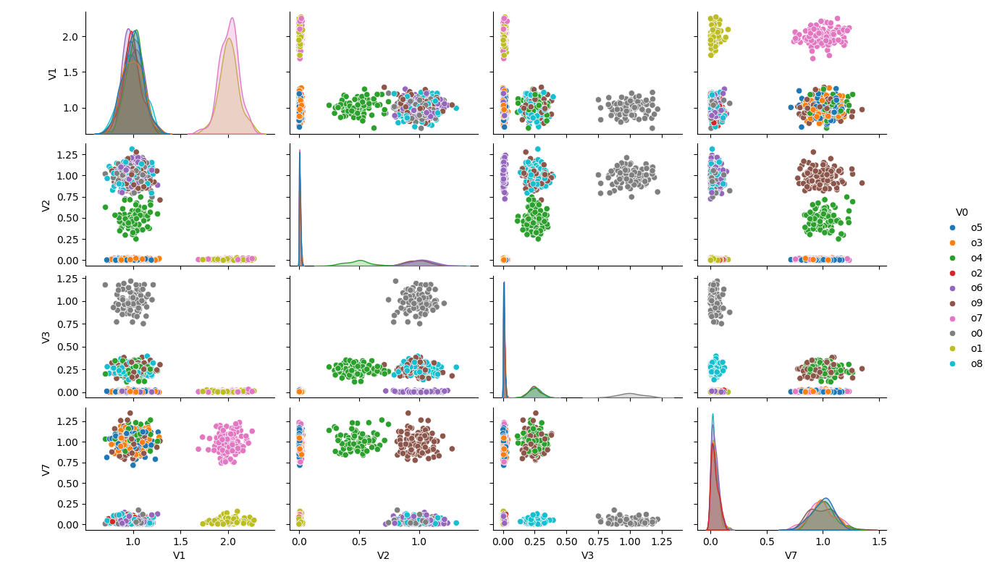
O Classifier (continued)
Data Analysis
Data is not linearly distributed and significant amount of overlapping exists between groups.

Slide 9
O Classifier (continued)
Cross Validation Statistics
Lasso & Ridge (ENET)
Random Forest

Slide 10
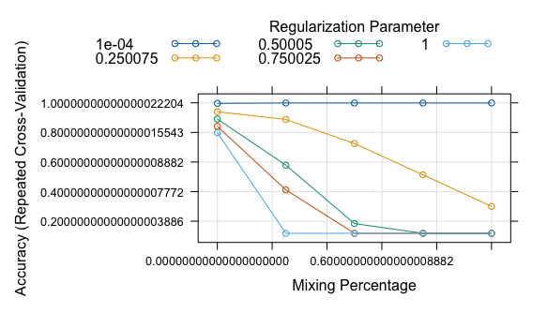
O Classifier (continued)
Optimum alpha and
Lambda values -
code-snippet

Slide 11
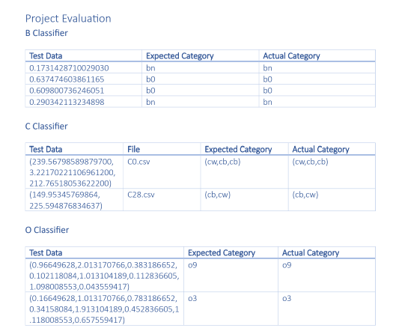
Evaluation & Test Statistics
In summary : All three classifiers (B,C and O) have performed well on the provided test data, accurately predicting the expected categories for each instance. The accuracy of the classifiers appears to be high based on the results.
Notes:
Team Nebula’s codes are more specific to the classification task at hand while calculates means and differences for classification, and reads datasets directly from specific file paths. While our codes uses more generalized functions, involves reading datasets from files interactively, and utilizes external packages for model training and prediction

Slide 12
Real Life Application
B_Classifier
Decision Making
Quality Assessment
C_Classifier
Quality control
Healthcare
0_Classifier
Pattern recognition
Finance
Quality control
Notes:
B_Classifier : Decision Making: Classifying a single numerical measurement into categories like "bn" (buy) or "bo" (sell) in financial decision-making processes.
Quality Assessment: Determining whether a single measurement falls into a normal ("bn") or outlier ("bo") category in quality control scenarios.
C_Classifier : Quality Control: Classifying measurements as acceptable ("cb") or unacceptable ("cw") in manufacturing processes.
Healthcare: Categorizing patient test results as normal ("cb") or abnormal ("cw").
Finance: Predicting whether a financial transaction is legitimate ("cb") or suspicious ("cw").
0_Classifier : Pattern Recognition: Classifying a set of features into one of multiple predefined classes, such as recognizing handwritten digits or images in computer vision.
Quality Control: Assigning a quality rating ('o0' to 'o9') based on features measured in a manufacturing process.

Slide 13
Best Rated Vendor
Team Nebula
B Classifier
Most Accurate categorization
C Classifier
Broad selection of input file selection
O Classifier
Nicely trained model to cover 8 features
Reliable and Accurate
Advanced ML techniques

Slide 14
Team Collaboration Experience
Taking into consideration the input of customers and vendors was both a complex and enriching experience.
Benefits | Drawbacks
Diversity in perspectives and ideas to the table. Creative problem-solving solutions on our own code. Exchange of skills and knowledge Peer reviews and collaborations contributed to an improvement on our code quality. Help in spotting unseen errors, enhancing readability and enforcing best practices. | Differences in terminology, coding styles, or understanding of the issue led to misunderstanding and a decrease of productivity.

Slide 15

Insights
Insight 1
The group A3MOS forgot to mention that the working directory must be set by the team evaluating the code in C_Classifier. Therefore, without this indication the code didn’t work whereas if they provided us this information from the beginning the code would have run smoothly. After a few misunderstandings and several mail exchanges, the problem was resolved.
Insight 2
Another problem encountered was that most groups didn’t include screenshots of our code when they reviewed it and therefore grasping the exact issues they mentioned was harder than it should have been.

Slide 16
Group ratings
Group Name | Nice to deal with | Responsive | Problem resolving
Mckintel | 5 | 5 | 4
Innovista | 5 | 5 | 4
Nebula | 5 | 3 | 3
Warriers | 5 | 3 | 3
A3MOS | 5 | 5 | 5

Slide 17
THANK YOU!

